Slide 1
Week-9: Gladiators
Team Members: Shivani Asokumar, Akash Narang, Mit Jain, Juhi Malkani
Team Lead: Akash Narang

Slide 2
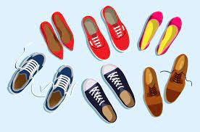
Project: E-commerce Website for Footwear

Slide 3
Team Progress Update
Static Seller page
Integration of APIs into seller page (In progress)
Product Listing API integration
Shopping Cart feature
Frontend
Backend APIs have been setup
Product Listing API (completed)
Seller Page APIs (completed)
Individual Product Page, Wishlist, Shopping Cart APIs (In progress)
Backend

Slide 4
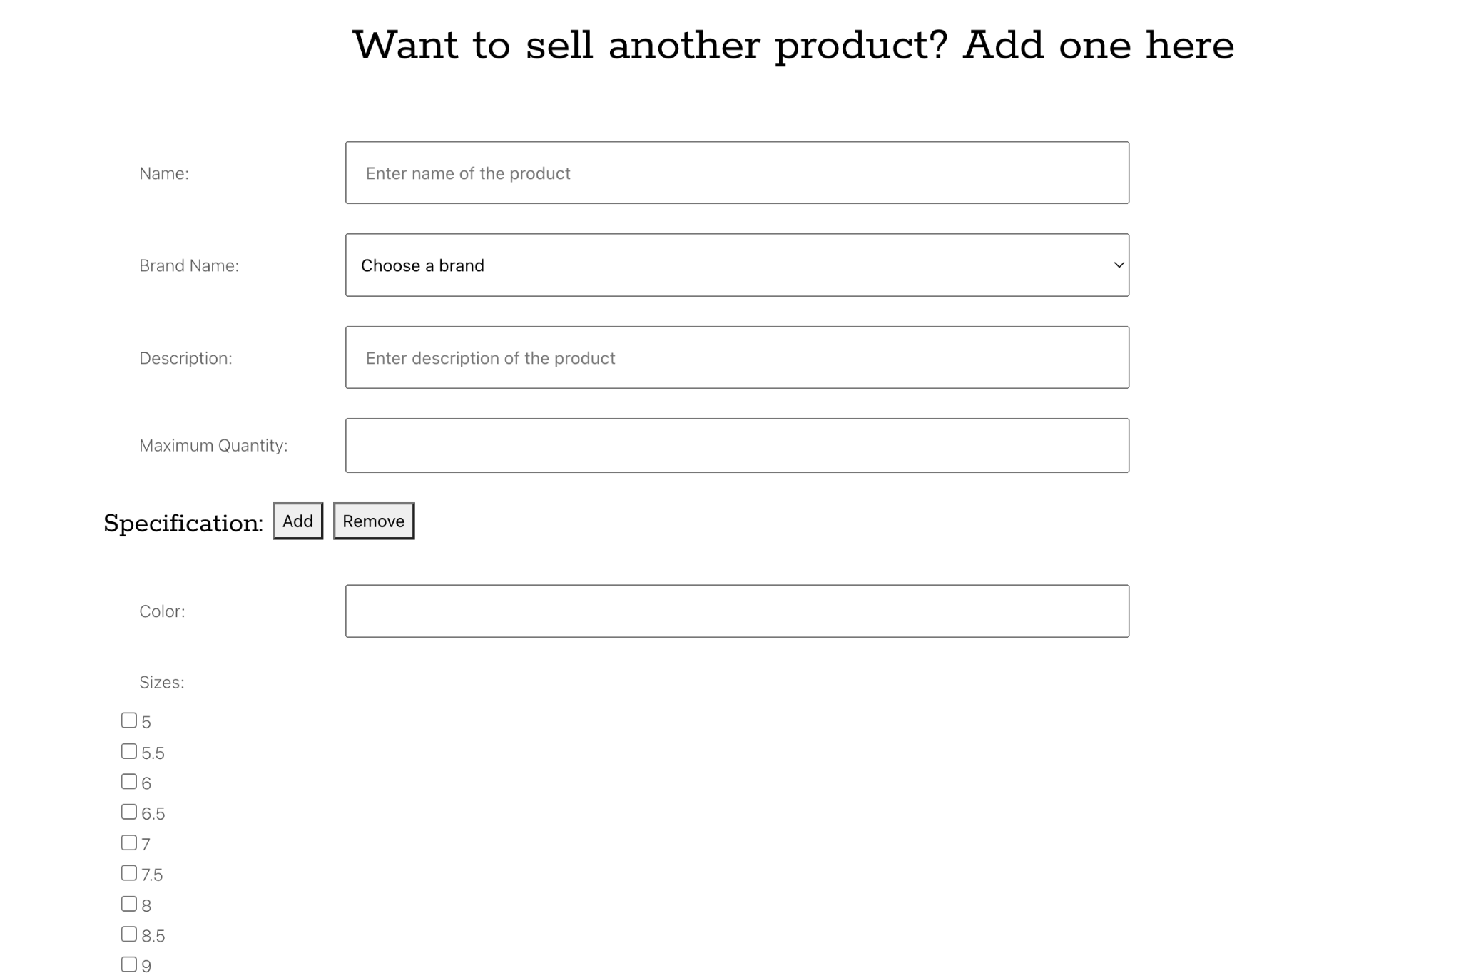
Static Seller Page (Completed)

Slide 5
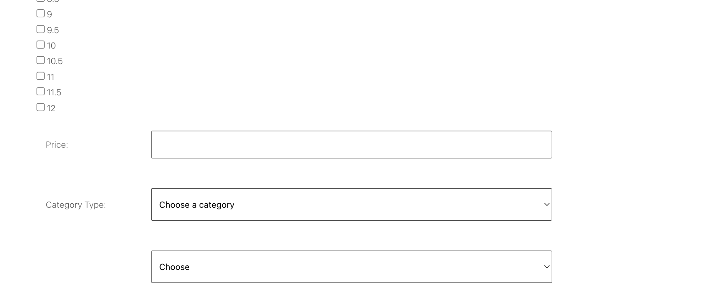
Static Seller Page (Completed)

Slide 6
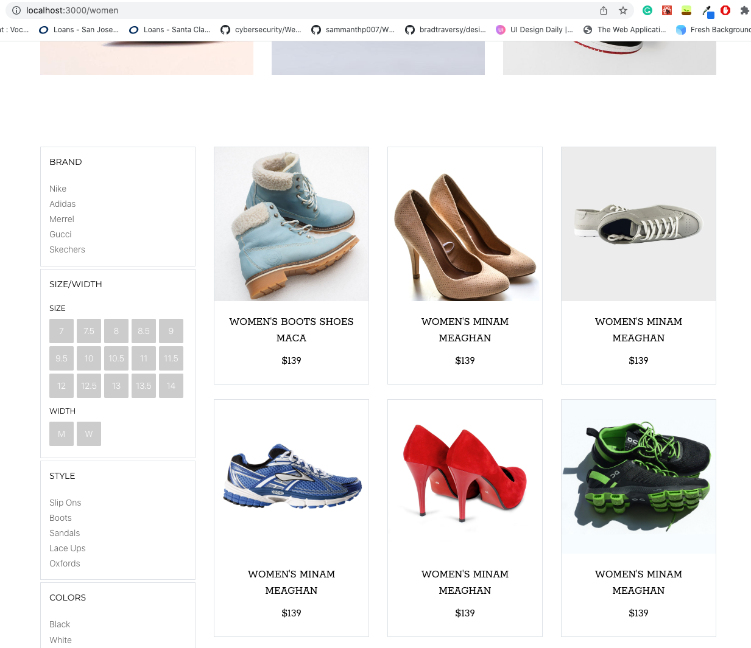
Product Listing

Slide 7
Test Plan
Cart: Should display # products in cart and info
Men/Women’s: Should filter items based on gender
Best Sellers: Should be displayed on home page with trending products
Checkout/Payment: Users should be able to complete their purchase
Order Summary: Should display order number and details

Slide 8
Test Plan
Seller page: should allow the seller to add items to the inventory, should display a form
User Authentication: Should allow users to login or create an account. Authenticates the users

Slide 9
How to make it user friendly?
Password validation (set requirements for passwords)
Shopping cart: display product details concisely
If user has existing account, they will be directed to login page
Clean UI for the website and easy navigation

Slide 10
Milestones
M1
Seller Page
M2
Shopping Cart
M3
Men/Women
Best Sellers
M4
User Auth
Order Summary
M5
Checkout/Payment

Slide 11
Luna R Feedback:
Setup was easy and smooth, one suggestion is to add setup instructions in readme.
The website is clean and neat.
On home page, there is something loading all the time? Not sure whether it is designed like this.
Can't register an account yet

Slide 12
Luna R Feedback Response:
The loading icon is temporary and will be fixed soon
User auth is not ready yet

Slide 13
Thanks!

